Slide 1
Erasmus +
Key Action 2
Capacity Building in the field of Higher Education
Call for proposals 2017
Giordana Bruno
EACEA
Napoli, 17 novembre 2016

Slide 2
OUTLINE
Capacity Building in the field of Higher Education
General overview
Project consortium and Financing rules
Application process and Selection procedure
CBHE – Information sources

Slide 3
PART I
General Overview of the Action

Slide 4

Erasmus+
Systems
Institutions
Individuals
KA3 Policy
BHE
KA2 Cooperation
KA1 Mobility
Notes:
A single integrated programme >> The new approach should simplify both the EU Educational Programmes as such as their management by covering all education, training and youth sectors in a holistic manner, bringing 7 existing programmes into a single coherent framework. This results in an presentation, that avoids fragmentation and artificial boundaries between the various actions and between the different areas, encouraging synergies and new forms of cooperation
Substantial simplications >> Regrouping actions with fewer calls makes the programme more user friendly. Also, a simplified financial management with greater use of unit costs and flat rate funding will switch the focus in the financial management from the input and individual budget headings to the outputs and the actual events which trigger a payment.
A substantial budget increase >> This is confirmed by the fact that Erasmus + was allocated a total budget of 14.7 billion € , which represents a 40 % increase to the previous budget - at a time when the overall EU expenditure has been cut. Furthermore EUR 1.68 billion come from EU external budget used in the context of the External Relations activities used solely for international dimension
Main objectives higher education
Increase the skills and employability of students and contribute to the competitiveness of European economy
Improve quality in teaching and learning
Implement the Higher Education Modernisation strategy in programme countries and raise the capacity of partner countries
Streamline the international dimension in Erasmus+
Support the Bologna process and policy dialogues with strategic partner countries

Slide 5
CBHE Programme and Partner Countries
Programme Countries (33 countries paying a contribution to E+) | CBHE Eligible Partner Countries (> 150 countries)
EU Member States: Austria, Belgium, Bulgaria, Croatia, Cyprus, Czech Republic, Denmark, Estonia, Finland, France, Germany, Greece, Hungary, Ireland, Italy, Latvia, Lithuania, Luxembourg, Malta, Netherlands, Poland, Portugal, Romania, Slovakia, Slovenia, Spain, Sweden, United Kingdom Other programme countries: Iceland, Liechtenstein, Norway, former Yugoslav Republic of Macedonia, Turkey.
Region 1: Western Balkans
Region 2: Eastern Partnership
Region 3: South-Mediterranean
Region 4: Russian Federation
Region 6: Asia
Region 7: Central Asia
Region 8: Latin America
Region 9: Iran, Iraq, Yemen
Region 10: South Africa
Region 11: African, Caribean and Pacific
Ineligible Partner countries:
Regions 5, 12 and 13
Notes:
Ineligible Partner countries:
Region 5: Andorra, Monaco, San Marino, Vatican City State, Switzerland
Region 12: Industrialised Gulf Cooperation countries: Bahrain, Kuwait, Oman, Qatar, Suadi Arabia, United Arab Emirates
Region 13: Other industrialised Countries: Australia, Brunei, Canada, Hong Kong, Japan, (Republic of) Korea, Macao, New Zealand, Singapore, Taiwan, United States of America

Slide 6
CBHE Principles
Institutional-
Systemic approach
Bottom-up programme
Involvement of national authorities
Strong emphasis on dissemination sustainability and exploitation of results
Structural Impact
Notes:
A pivotal element in this respect is the institutional and systemic approach which means that the programme aims directly at institutions rather than individuals and at systems rather than independent processes. Capacity-Building Projects are expected to have a long term structural impact.
Bottom-up: mainly implemented through calls for proposals seeking projects targeting reforms in higher education institutions and/or systems
International consortia with a balanced involvement of business, higher education institutions and especially national, regional and local authorities are essential for addressing the Calls target reforms in HE and/or systems. This is particularly the case in emerging economies where Europe needs to develop balanced cooperation in order to ensure a stronger and sustained local presence. Partnerships which aim to foster quality of HE providing skills needed at the respective labour markets triggering innovative approaches, entrepreneurial skills and attitudes in learners will bring benefits both to European competitiveness and to partner countries. National Authorities and namely Ministers of Education are also consulted as regards the priority setting for certain countries (Ex-Tempus).
Importance given to dissemination and exploitation of results to ensure sustainability and bigger impact on the process of modernisation of Higher Education (impact on teaching/learning processes; curriculum development/ upgrading Information Technologies/ staff mobility / promoting Bologna principles, etc.
Structural Impact: The impact is expected on "structures" rather than on individuals, i.e., at institutional / national level (reason for which "structural projects" are proposed as distinctive category).

Slide 7
CBHE Objectives
CBHE projects aim at achieving a long lasting impact on the Partner Countries HE institutions and systems through:
Improving the modernisation and quality of HE and its relevance for the labour market and society;
Improving the competences and skills in HEIs via innovative education programmes
Enhancing the management, governance and innovation capacities, as well as the internationalisation of HEIs
Increasing capacities of National Authorities to modernise their higher education systems
Fostering regional integration+ cooperation between different regions of the world
Notes:
The programme is aimed at using HEI as a vector to deliver the knowledge requirements for economic development through job creation, better governance, increased entrepreneurship and mobility, and a stronger civil society.
Enhancing management, governance and innovation capacities, and the internationalisation of HEIs as well as modernising education systems is one of the expected impact of the programme together with regional and cross regional cooperation.
European HEIs acknowledge that they have a key role to play in supporting the modernisation efforts of emerging and developing parts of the world, as well as to contribute to finding solutions to global challenges such as climate change or narrowing development gaps between peoples and nations.

Slide 8
CBHE – Types of Projects
Joint Projects:
curriculum development
university governance & management
Links between HE institutions and the wider economic and social environment
=> Impact Institutions
Structural Projects:
modernisation of policies, governance and management of higher education systems
Links between HE systems and the wider economic and social environment
=> Impact Systems
Special Mobility Strand

Slide 9
Joint Projects – Examples of Activities
Development, testing and adapting of curricula, learning and teaching materials, tools and methods for professional development of academic and administrative staff, new governance and management systems and structures
Organisation of staff training (academic and non academic)
Strenghtening of the internationalisation of HEI and the capacity to network effectively in research, scientific and technological innovation
Upgrading facilities necessary to implement innovative practices (i.e. for new curricula and teaching methods, for the development of new services)
Notes:
Joint Projects
curricula, courses, materials and tools, methodologies + pedagogical approaches;
new forms of practical training schemes and study of real-life cases in business and industry
university-enterprise cooperation, including the creation of business start-ups
new forms of learning and teaching (virtual mobility, OER and ICT)
guidance, counselling and coaching methods and tools
tools and methods for professional development of academic and administrative staff
quality assurance at programme and institution level
new governance and management systems and structures
modern university services e.g. for financial management, international relations, student counselling and guidance, academic affairs and research
strengthening of the internationalisation of HEI and the capacity to network effectively in research, scientific and technological innovation (international openness of curricula, student services, inter-institutional mobility schemes, scientific cooperation and knowledge transfer…);
upgrading of facilities necessary to the implementation of innovative practices (e.g. for new curriculum and teaching methods, for the development of new services, etc.);
organisation of staff trainings involving teaching and support staff, technicians as well as university administrators and managers.

Slide 10
Structural Projects – Examples of Activities
Strengthening of internationalisation of higher education systems;
Introduction of Bologna-type reforms (i.e. three-level cycle system, quality assurance, evaluation)
Implementation of transparency tools such as credit systems, accreditation procedures, guidelines for the recognition of prior and non-formal learning;
Strengthening the integration of education, research and innovation
Notes:
Structural Projects
strengthening of internationalisation of higher education systems;
introduction of Bologna-type reforms (three-level cycle system, quality assurance, evaluation, etc.);
implementation of transparency tools such as credit systems, accreditation procedures, guidelines for the recognition of prior and non-formal learning etc.;
establishment of National Qualification Frameworks;
development and implementation of internal and external quality assurance systems/guidelines;
development and implementation of new approaches and tools for policy making and monitoring, including the establishment of representative bodies, organisations or associations;
strengthening the integration of education, research and innovation.
In more concrete terms, these activities can include:
surveys and studies on specific reform issues
policy and expert advice
organisation of conferences, seminars, workshops, round tables (which should result in operational conclusions and recommendations)
organisation of staff trainings on policy issues
organisation of staff trainings (which may include the production of training manuals and guidelines) involving teaching and support staff, technicians as well as university administrators and managers.
organisation of awareness-raising campaigns.

Slide 11
Special Mobility Strand
Special Mobility Strand
Partner Countries eligible (ONLY):
Region 1: Western Balkans
Region 2: Eastern Partnership countries
Region 3: South-Mediterranean countries
For whom?
Students registered in HEIs involved in project consortia
Staff employed in a HEI or enterprise in project consortia
Programme Country to Programme Country flows are ineligible
Conditions:
Mobility should be instrumental and integrated in projects objectives (no mobility on its own)
Added value and/or innovative character of the activities proposed (approx. 40% of the selected projects will receive additional funding)
Comply with provisions of Erasmus Charter for Higher Education
Notes:
For projects with Regions 1, 2 and 3, projects may include, a Special Mobility Strand for staff and students (WB, Neighbourhood)
(section "Eligible Countries" in Part A of this PRG Guide),
Higher education institutions (HEIs) located in a Programme Country must hold a valid Erasmus Charter for Higher Education (ECHE). An ECHE is not required for participating HEIs in eligible Partner Countries; However for the Special Mobility Strand, HEIs located in the eligible Partner Countries will have to have established inter-institutional agreements with all partner HEIs, endorsing the principles of the ECHE.
In the application form, the applicants for a Special Mobility Strand for higher education students and staff will have to provide the following information:
number of students and staff that are supposed to take part in mobility activities during the life-time of the project;
average duration per participant of the planned mobility activities;
hosting and sending institutions
Not to be confused with travels in projects including small-scale and short term activities for HEI students and staff (academic and non) if in the interest of objectives, like project meetings, seminars etc. – Students can travel only 2 weeks-2 months (e.g., to participate as student representative in a project meeting on governance etc.)
project selection :
not all selected projects may be granted a SMC
Selection of individuals done by consortium
"It is expected that no more the 40% of the Joint or Structural projects selected for funding will benefit from such a grant"

Slide 12
Special Mobility Strand activities
Special Mobility Strand
Students:
Study periods (3-12 months)/traineeships-work placements (2-12 months)
covers all cycles (BA, MA, PhD)
corresponds to study area/academic disciplines addressed by the project
Students from HEIs of the consortia can study at partner HEI or do a traineeship at a consortia partner country institution
Staff:
teaching & training periods (5 days to 2 months)
teaching period: HEI teaching staff /staff from enterprises to teach at a partner HEI abroad
training period: HEI teaching and non-teaching staff can attend (only for staff of partner countries)
a) structured courses/training events (conferences excluded); b) job shadowing/observation periods/trainings at a partner HEI/ relevant organisation in a consortia country

Slide 13
Who can apply?
As applicant:
A higher education institution (HEI)
An association or organisation of HEIs
a legally recognised national or international rector, teacher or student organisation (for Structural Projects ONLY)
As eligible participating organisation:
A higher education institution (HEI)
any public or private organisation active in the labour market or in the fields of education ,training and youth
Each participating organisation must be located in a Programme Country or in an eligible Partner country.
Associated partners can contribute to the implementation of specific project tasks/activities or support the dissemination and sustainability of the project without receiving funding.
Notes:
Exception: participating organisations from Libya and Syria (Region 3) as well as from the Russian Federation cannot act as applicants.
Specific provisions for Ukraine:
In the case of Ukraine, eligible HEIs are only those recognised by the Ministry of Education and Science of Ukraine (contact the Ukranian NEO for further information).
A participating organisation can be:
any public or private organisation offering higher education degrees or other recognised tertiary education level qualifications (defined as higher education institution and recognised as such by the competent authority)
or
any public or private organisation active in the labour market or in the fields of education ,training and youth. For example, such organisation can be:
a public, private small medium or large enterprise (including social enterprises)
a public body at local, regional or national level (including ministries)
a social partner or other representative of working life, including chambers of commerce, craft/professional associations and trade unions
a research institute
a foundation
a school/institute (on any level, from pre-school to upper secondary education, including vocational education and adult education)
a non-profit organisation, association, NGO (including national or international associations or networks of higher education institutions, students or teachers associations, etc.)
a cultural organisation, library, museum
a body providing career guidance, professional counselling and information services

Slide 14


Part II – The Consortium and the financing rules

Slide 15

Consortium Structure
Programme Countries
Partner Countries
Min. 3 Countries
min. 1 HEI each
Min. 1 Country
min. 2 HEI /each
Structural Projects:
Partner Country Ministries for HE must participate
At least as many
Partner Country HEIs as Programme Country HEIs
  ATTENTION: Exception Russia Latin America, Syria, Libya

Slide 16
Priorities & Types of projects
National Projects must address:
National Priorities defined by the Ministries of Education in close consultation with the EU Delegations for partner countries in Regions 1,2,3,7,10
Regional priorities defined by the Commission and based on EU's external policy priorities for the Regions where no national priorities are established (Regions 4,6,8,9,11)
Multi-Country Projects
Regional priorities apply to multi-country projects in the same region
Combination of regional + national priorities common to all partner countries may also be accepted
(in particular for cross-regional projects)

Slide 17
Priorities – Categories/Types of Activities
Types of Activities Categories of Priorities | Curriculum Development | Governance and Management | Higher Education and Society
A. Subject Areas | X
B. Improving quality of education and training | X | X | X
C. Improving Management and operation of HEIs |  | X
D. Developing the HE sector within society at large |  |  | X
Notes:
National and regional priorities are the same, only that they were defined at different levels (national – by partner countries; regional – by Commission services)
Both apply equally to Joint and Structural projects, the difference is only in the impact expected (national at institutional level; structural at systemic level)
Four categories of priorities acting as follows:
A. Subject areas - only to Curriculum development ("Modernisation of curriculum by developing new and innovative courses and methodologies ")
B. Improving quality of education and training is transversal; can be used either self-standing, or in combination with A, C or D e.g. Creation of an e-learning platform for Mathematics and Statistics.
C. Improving management and operation of higher education institutions, applies to projects dealing with "Modernisation of governance, management and functioning of higher education"
D. Developing the higher education sector within society at large, applies to projects dealing with "Strengthening of relations between higher education and the wider economic and social environment"

Slide 18
Budget and duration
Duration 24 or 36 Months
Min. 500,000 - Max. 1,000,000 €
5 Budget Headings
Real Costs and Unit Costs
Excluding Mobility Strand

Slide 19
Maximum EU grant for the Special Mobility Strand
Special Mobility Strand
Up to max. 80% of the total EU grant awarded for the joint or structural project (excluding the mobility strand)
Travel costs (students and staff)
Subsistence costs
Notes:
The contribution to the travels is based on a unit-cost depending on the travel distance per participant. Travel distances must be calculated using the distance calculator supported by the European Commission (http://ec.europa.eu/programmes/erasmus-plus/tools/distance_en.htm).
The contribution to the travels costs will be managed by the partnership and the agreed modalities shall be part of the partnership agreement.

Slide 20
Budget Categories
Staff costs (max 40%) | 4 Staff Categories (Manager, Researcher/ Teacher/Trainer, Technician, Administrator)
Travel costs | Students/staff from partners from their place of origin to the venue of the activity and return. Activities and related travels must be carried out in countries involved in the project.
Costs of stay | Subsistence, accommodation, local and public transport, personal or optional health insurance.
Equipment (max 30%) | Exclusively for the benefit of HEIs in the Partner Countries
Sub-contracting (max 10%) | For services /competences that can't be found in the consortia
Notes:
Ineligible Costs
expenses for activities and related travel that are not carried out at the project partners
equipment such as: furniture, motor vehicles of any kind
equipment for research and development purposes, telephones, mobile phones, alarm systems and anti-theft Systems
costs of premises (purchase, heating, maintenance, repairs etc.)
costs linked to the purchase of real estate
depreciation costs

Slide 21
Budget allocation and justification
5 Budget Categories
Staff - UC
Travel – UC
Cost of Stay – UC
Equipment – RC
Sub-contracting – RC
2 Allocation / Justification Methods
Real Costs
(RC)
Unit Costs
(UC)
Other types of costs (ex.: dissemination, publishing, overheads costs, etc.) are not considered for the calculation of the grant.
>>> Expected to be covered by co-funding.
Notes:
Estimated budget of CBHE projects will be a combination of unit costs and real costs:

Slide 22
The types of costs
Real costs: How did you use the grant ?
  => input based
=>Expenses incurred, supporting documents
Unit costs: what did you achieve with the grant ? =>output based
=>- No need to prove the actual expenditure
Need to prove that the activity was justified and properly implemented (e.g. teaching, training)
A unit cost is a fixed contribution calculated on the basis of the principle of
no profit & co-funding and aimed at contributing to the implementation of a
specific activity or task.
Notes:
Unit costs are based:
Working group EAC/EACEA for E+ as a whole.
Statistical analysis of historical data of different programmes (including Tempus).

Slide 23
How to calculate the budget
Real costs:
Estimate the real costs bearing in mind the eligibility rules and the maximum amounts (/percentages)
Unit costs:
Automatic calculation in the budget form based on the unit costs identified in the Programme Guide
Notes:
Unit costs are based:
Working group EAC/EACEA for E+ as a whole.
Statistical analysis of historical data of different programmes (including Tempus).

Slide 24
How to calculate the budget
Unit Costs
for
the Grant Allocation
Based on volume (/nature) of activities proposed in the application
the Grant Justification
at final report
Based on the quality and appropriateness of the activity
Use of the Grant
internal decision of the partnership formalised in the Partnership Agreement
Notes:
Grant Allocation : Unit Cost System
Justification: check not of actual expenses but that event (example trip) which is the basis of the unit calculation took place
Use of Grant: the amount calculated by the unit system can be used for whatever is neccessary to implement the
Project as described in the application and in accordance with the general financial rules (cost actually incurred, within the eligibility period, neccessary for the implementation etc.)

Slide 25
How to calculate the budget - STAFF COSTS
Financing mechanism for staff costs | Amount
Unit costs Subdivided in 4 categories and country groups (4 groups for Programme and 4 groups for Partner Countries) | per manager involved per day | Max. 40% of the total grant
 | per researcher/ teacher/trainer involved per day
 | per technician involved per day
 | per administrative staff involved per day
Notes:
Contribution to the costs of staff performing tasks which are directly necessary to the achievements of the objectives of the project
Conditional: applicants will have to justify the type and volume of resources needed in relation to the implementation of the proposed activities and outputs. The contribution is provided on the condition that the salary for the same tasks is compensated only once.
The category of staff to be applied will depend on the work to be performed in the project and not on the basis of the status or title of the individual. In other words, staff costs related, for example, to an administrative task that has been carried out by an academic should be charged under the category "Administrative staff". Actual remuneration modalities of staff involved in the project will be defined jointly by the organisations involved in the project, endorsed by the managers responsible for their employment and will be part of the partnership agreement to be signed among the partners at the beginning of the project. Failing to do so, the usual remuneration policy of the organisation concerned will apply.The unit-cost which will be applicable to calculate the grant will be the one of the country in which the staff member is employed, independently of where the tasks will be executed (i.e. a staff member of an organisation of Country A working (partly) in Country B will be considered for the unit-costs under Country A).

Slide 26
How to calculate the budget - Travel/Cost of Stay
Costs of Stay
Travel Costs
DAYS | STAFF | STUDENTS
1-14 | 120€ | 55€
15-60 | 70€ | -
15-90 | - | 40€
61 – 90 | 50€ | n.a.
Distance Bands (one way) | Unit Cost (return trip)
100-499 km | 180€
500-1999 km | 275€
2000-2999 km | 360€
3000-3999 km | 530€
4000-7999 km | 820€
8000 km and more | 1.100€
Notes:
To be noted: unit-costs for staff will be lower than the current Tempus references (maxima).
The contribution from the EU is based on a unit-cost per travel (return-trip).
Travel costs concern transport at national and international level above 100 km (single distance trip). The contribution requested by the applicant to the travel costs results from multiplying the number of travels with the unit cost corresponding to the relevant distance band.
Travel distances must be calculated using the distance calculator supported by the European Commission (http://ec.europa.eu/programmes/erasmus-plus/tools/distance_en.htm)
No support for travel less than 100 KM
If duration is between the categories calculation is as well (example 20 days = 14 X Rate 1 + 6 X Rate 2)

Slide 27
How to calculate the budget
STUDENTS - Cost of Stay
Special Mobility Strand
Students from Programme Countries
Costs of Stay €/Month
Students from
Partner countries
Irrespective of hosting country
650 €
Country group 1 hosting | Country group 2 hosting | Country group 3 + 4 hosting
850 € | 800 € | 750 €

Slide 28
How to calculate the budget
STAFF Costs of Stay
Special Mobility Strand
Cost of Stay €/Day
Staff from Partner Countries
Cost of Stay €/Day
Staff from Programme Countries
Days | Country group 1 hosting | Country group 2 hosting | Country group 3 hosting | Country group 4 hosting
1-14 | 160 € | 140 € | 120 € | 100 €
15-60 | 112 € | 98 € | 84 € | 70 €
Days | Irrespective of hosting country
1-14 | 160 €
15-60 | 112 €

Slide 29
Part III – The application and
Selection procedure

Slide 30
Selection results 2016
Stage | 1 Western Balkans | 2 Eastern Partnership | 3 South Med | 4 Russian Federa-tion | 6 Asia | 7 Central Asia | 8 Latin America | 9 Iran, Iraq, Yemen | 10 South Africa | 11 ACP | Total*
Reception | 109 | 238 | 169 | 78 | 78 | 101 | 78 | 8 | 14 | 53 | 736
Eligible | 93 | 219 | 146 | 77 | 68 | 93 | 72 | 8 | 13 | 42 | 653
Sent to Consultation | 37 | 64 | 80 | 35 | 57 | 49 | 31 | 5 | 6 | 19 | 287
Proposed for funding | 18 | 24 | 36 | 16 | 53 | 19 | 14 | 4 | 5 | 9 | 147
Success rate | 17% | 10% | 21% | 21% | 68% | 19% | 18% | 50% | 36% | 17% | 20%
(Selected project in 2015) % 2016 as compared to 2015 | (15) +20% | (23) +4% | (40) -10% | (13) +23% | (27) +96% | (23) -17% | (19) -26% | (2) +100% | (4) +25% | (0) - | (140) +5%
* The number of projects by region cannot be added considering that a project can cover different regions.
Erasmus+
Notes:
The trends compared to the 2015 selection are shown in +/- %, where the cases in red (decrease/increase) in number of projects, and they refer to:
South Mediterranean countries: in 2015, 5M€ where available as "Jordan Window" in addition to the originally earmarked budget for this region
Central Asia and Latin America received in 2015 approx. 4.5 M€ from Asia, which has to be returned progressively in 2016 and 2017, therefore the number of projects under the actual Call has decreased
Considerably higher number of projects received this year involving countries from region 6 Asia permitted a much better absorption of the regional budget this year.
The roadmap indicating the remaining steps and dates is indicated on the slide as well.

Slide 31
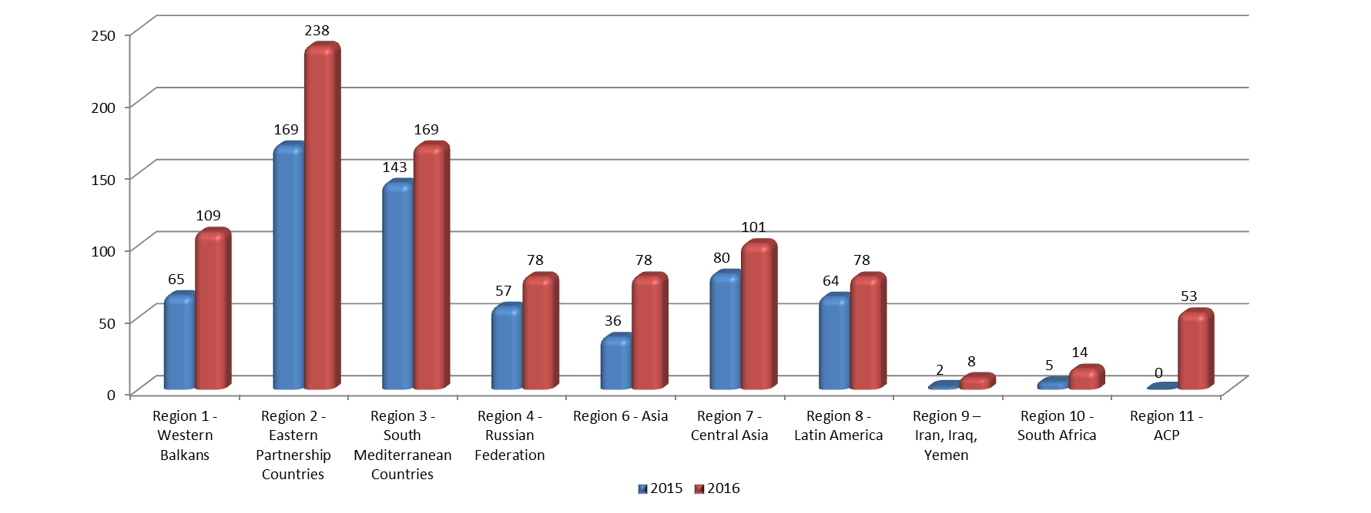
Selection: evolution of the applications (2015-2016)

Slide 32
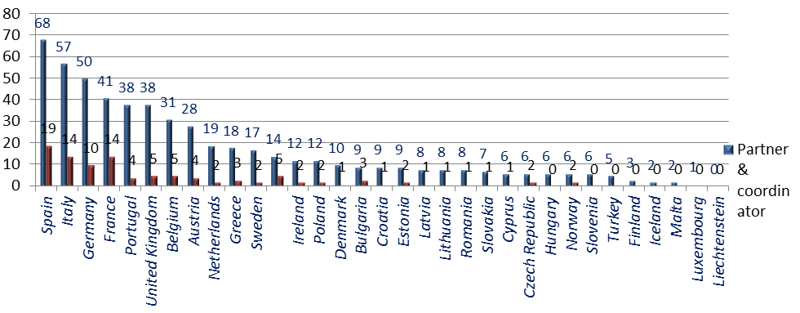
Participation of the Programme countries in the 2016 selected projects

Slide 33
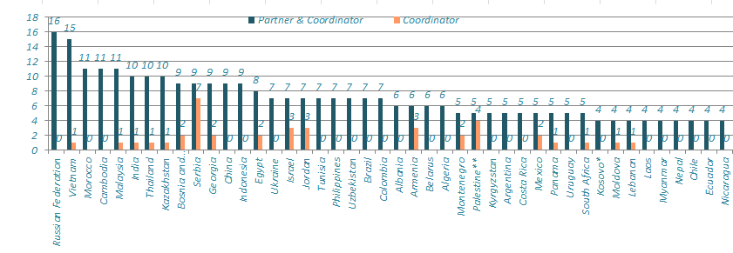
Participation of the Partner countries in the 2016 selected projects

Slide 34
Key messages for the 3rd Call
Keep on intensifying efforts to encourage the cooperation with Asian countries;
Disseminate widely the new opportunity to cooperate with ACP countries, in particular Caribbean and Pacific Countries;
Pay particular attention to the eligibility criteria, mainly minimum number of nationally recognised HEIs in consortia;
Encourage the diversification of projects in terms of overall and specific objectives, activities, target groups and consortium composition;
Revision of national and regional priorities will start early in 2017 (applicable to the 2018 call);
Insist on the need to empower the Partner Country partners from the early stages of the proposal preparation;
Be innovative in the content and methodologies described in your application.

Slide 35
Indicative Budget for 2017 Call

Slide 36
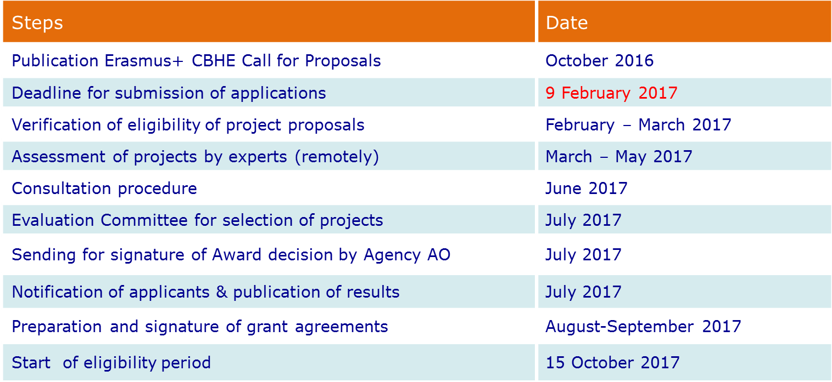
Application and Selection procedure
Indicative roadmap for selection process-CBHE

Slide 37

What is assessed?
Eligibility
criteria
Exclusion and selection criteria
Award
criteria

Slide 38
What is assessed?
Eligibility Criteria
Formal submission requirements
Applicant, Partners and Partnership requirements (number of partners, status of the grant applicant & partners, etc.)
Grant size and duration
Notes:
Formal submission requirements :
Official eForm and submission system
Official language
Respect of deadline
Annexes (Budget, Mandates... – duly filled in)
Documents signed by the legal representative of the institution
It does not matter
how well the project has been designed if it does not fulfil the eligibility criteria: this will lead to the automatic rejection of the proposal

Slide 39
What is assessed? Exclusion and Selection Criteria
The institution is not in one of the situations described in section C. Exclusion criteria of the Guidelines (such as bankruptcy, professional misconduct, subject of fraud, corruption, administrative penalties, conflict of interest, etc.)
Legal person status of the applicant organisation
Financial capacity to complete the proposed activities (private entities only)
Operational capacity to complete the proposed activities
Based on supporting and administrative documents, like the declaration of honour, legal entity form, profit and loss accounts...
Notes:
The signature on the Declaration of Honour must belong to the same person that is indicated in Part A.3 of the application form: the person legally authorised to signed on behalf of the applicant institution.
Financial capacity +
The verification of the financial capacity does not apply to:
public bodies;
international organisations.
Financial Capacity Form, including the applicant’s profit and loss account and the balance sheet for the last 2 financial years for which accounts were closed.
Declaration of honour is attached to the Eform
Legal entity form , Financial capacity form and their annexes have to be uploaded on the organisation's PIC account.

Slide 40
What is assessed? Award Criteria
Relevance
(30 points)
Quality of
Design + Implementation
(30 points)
Quality of
Team + Cooperation arrangements
(20 points)
Impact and Sustainability
(20 points)
To be considered for funding, proposals must score
at least 60 points in total and - out of these points at least 15 points for "Relevance"

Slide 41
What is assessed? - Award Decision
EACEA takes decision based on:
Evaluation Committee's recommendation, taking into account:
- ranking list on quality established by independent experts
- consultation process with EU Delegations, Partner Countries authorities and NEOs
- the budget available for each region
- the need to achieve a geographical balance within a region
- sufficient coverage of the priorities

Slide 42
CBHE Information sources
Erasmus+ website - EACEA
http://eacea.ec.europa.eu/erasmus-plus/actions/key-action-2-cooperation-for-innovation-and-exchange-good-practices/capacity-0_en
Erasmus+ website – EU Commission
http://ec.europa.eu/programmes/erasmus-plus/index_en.htm
Erasmus+ e-tutorials:
https://eacea.ec.europa.eu/erasmus-plus/introduction-international-dimension-erasmus-plus_en
International E+ International Contact Points (ICPs) in Programme Countries
https://eacea.ec.europa.eu/erasmus-plus/contacts/international-erasmus-plus-contact-points_en
National Erasmus+ Offices (NEOs) in certain Partner Countries (PCs)
https://eacea.ec.europa.eu/erasmus-plus/contacts/national-erasmus-plus-offices_en

Slide 43


