Slide 1
"Placement Administration and Support System" – PASS

Slide 2
Placement Administration and Support System
PASS

Slide 3
New PASS Tool
Initial entry screen. Users representing EVS accredited organisations will see both European Solidarity Corps and Volunteering Database options. Representatives of non-EVS organisations will only see the Corps option.

Slide 4
New PASS Tool
On first login to PASS, all users must agree to the Mission and Principles, and to the data protection and Terms and Conditions statements (similar to the participant registration process.)

Slide 5
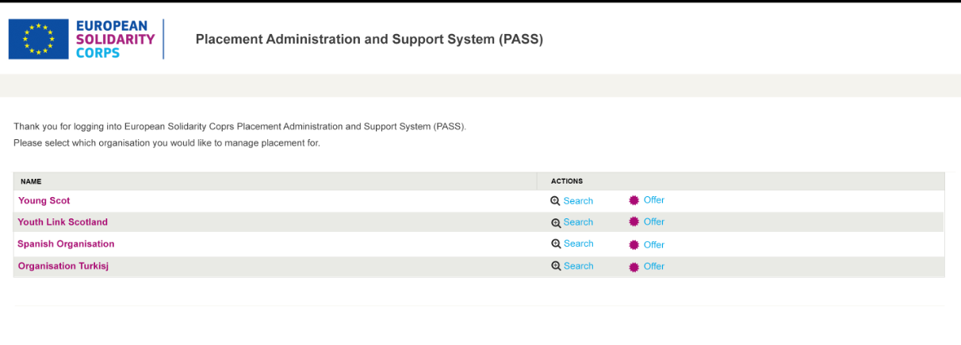
New PASS Tool
User chooses which organisation they want to administer through PASS. It is possible for one user to be authorised to manage placements on behalf of multiple organisations (already happens for EVS.)
Two possible actions – search for participants, or make an offer to a participant.

Slide 6
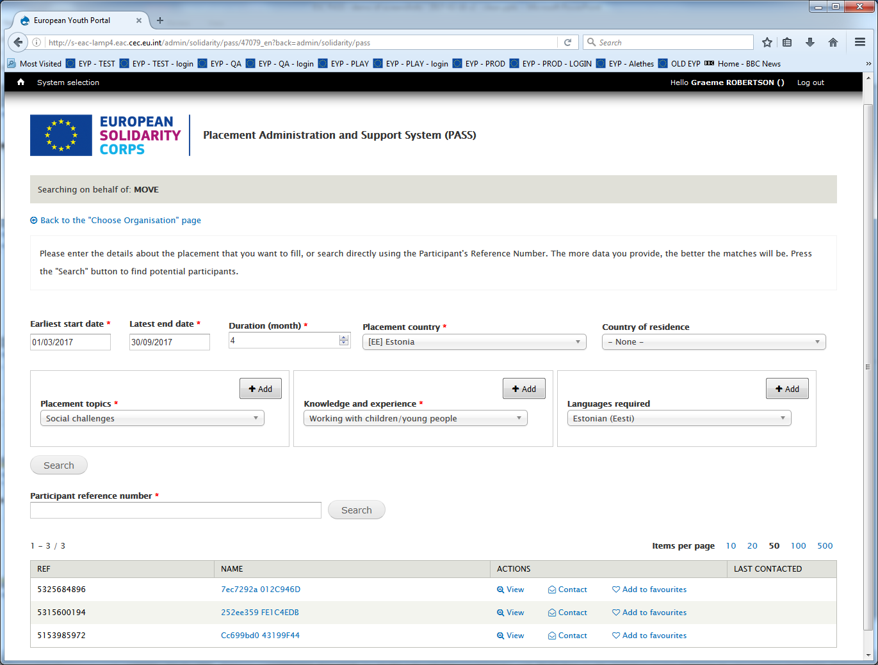
New PASS Tool
Enter details of the proposed placement to search for potential participants, or enter new Participant Reference Number. Suggested candidates are shown in table below. Will be enhanced in future releases.

Slide 7
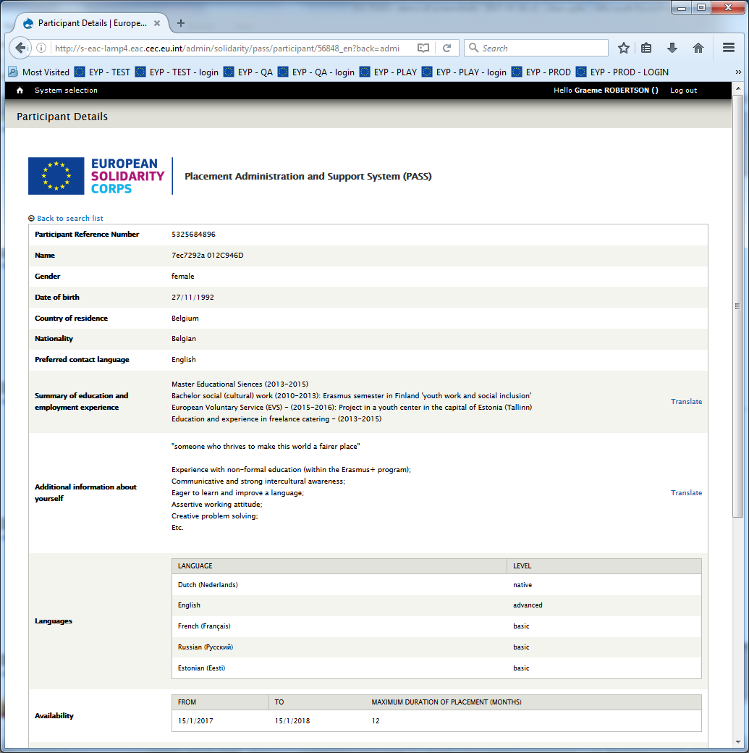
New PASS Tool
User can view details of participants shown in search results.
Personal contact details not shown for data protection reasons.
Details shown vary depending on whether search is for a Volunteering or Occupational placement.
(Note – the name shown here is anonymised for data protection reasons.)

Slide 8
New PASS Tool
When a user initiates contact with a participant, the chosen participant receives this email from the PASS tool, in their preferred contact language.
The user also receives a copy of the email, in English.
The participant can choose to reply and start discussions with the organisation, or ignore it.
This basic contact process will be enhanced in future releases.

Slide 9
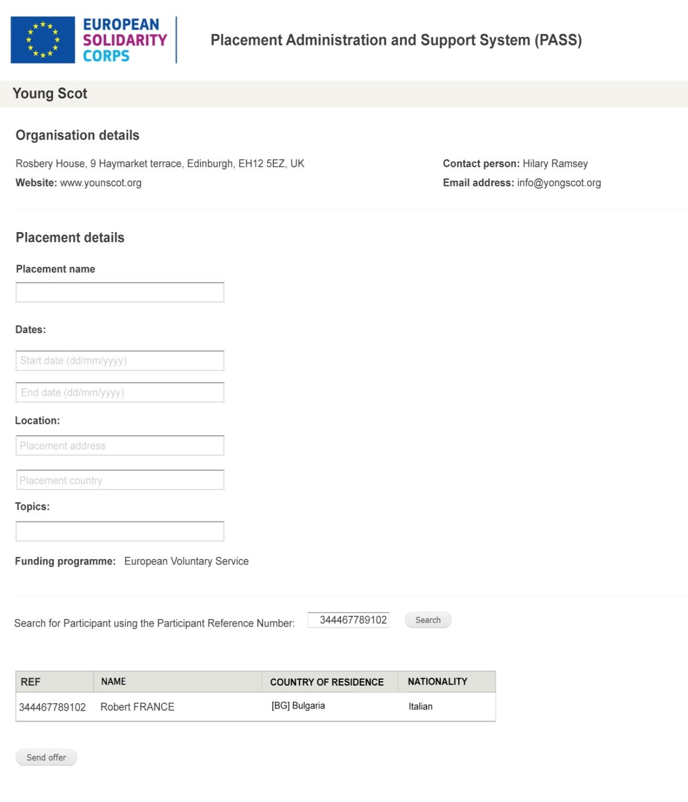
New PASS Tool
When a user finally wants to make an offer, they must enter the basic placement details into the system, and choose which participant to send the offer to.

Slide 10
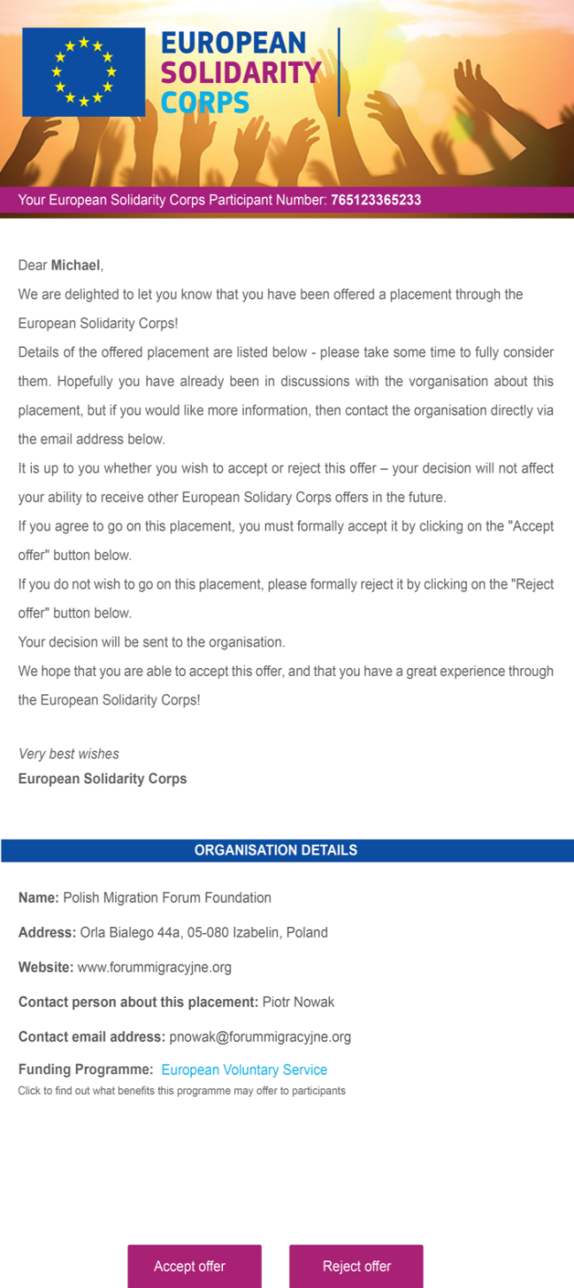
New PASS Tool
The chosen participant then receives this email from the PASS tool, in their preferred contact language, advising them that they have been offered the placement.
The user also receives a copy of the email, in English.
The participant can choose to Accept or Reject the offer by clicking on the buttons.

Slide 11
New PASS Tool
User is informed by email whether participant accepts or rejects the offer.
The outcome is also shown in the search results list.
This process will be enhanced in future releases.

Slide 12
Thank you for your attention! ☺
Any questions?

